Slide 2
Deployment Best Practices For Project Portfolio Server
Isabel Bernardos Galindo
IW Consultant – WW CoE EPM
Microsoft Iberica

Slide 3
Agenda
PPM Processes and Phases
Architecture Overview
Deployment Approach
Deployment Models
Hardware Sizing
User Authentication
Best Practices

Slide 4
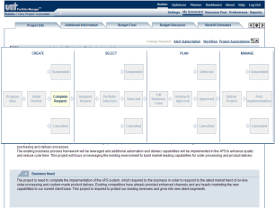
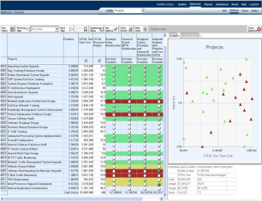
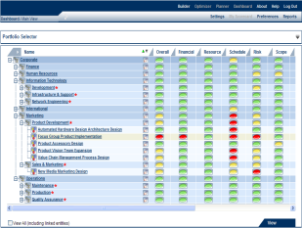






EPM Solution PPM Process And Architecture
Gov Phases:
Create
Select
Plan
Manage
Complete
Project
Request
Form
1st
Review
2nd
Review
Portfolio Prioritization
Detailed Planning
Portfolio Tracking
1
Strategic Value
1
Develop Project Plan
1
Change Request Mgt
2
Financial Value
2
Assign Named Resources
2
Status Reporting
PPM
Lifecycle Steps:
3
Risk Value
3
Define Inter-dependencies
3
Portfolio Re-Optimization
Business Case Development
1
Resource Requirements
Portfolio Optimization
Project Tracking
2
Cost Estimates
1
Charting Analysis
Final
Approval
Baseline
1
Project Tracking
3
Benefit Forecasts
2
Constraint Analysis
2
Resource Mgt
4
Strategic Alignment Assessment
3
Adv Portfolio Analytics
3
Time Reporting
Completed
5
Risk Assessment
Portfolio
Selection
4
Issues & Risk Mgt
6
Phase & Milestone Planning
5
Document Mgt
6
Team Collaboration
Microsoft EPM Solution:
Portfolio Builder
Portfolio Optimizer
Portfolio Dashboard
Project Portfolio 2007
Project Professional
Project Server 2007
SQL 2005
Notes:
Session 1
Implementation Workshop
4
Emphasize that the diagram addresses PPS usage, not implementation – It does not cover Settings

Slide 5
Implementation Approach MOPPS 2007
Implement
Install, Configure
Deploy, Support
Technology
Envision
Define
Vision/Scope
Plan
Define Solution
Usage and its Rollout

Slide 6
Implementation Approach MOPPS 2007
Implement
Install, Configure
Deploy, Support
Technology
Envision
Define
Vision/Scope
Discovery
Present capabilities
in terms of Usage
Scenarios
Define Vision Scope
Requirements
Requirements Specification
Mapping to Usage Scenarios
Plan
Define Solution
Usage and its Rollout

Slide 7
Implementation Approach MOPPS 2007
Implement
Install, Configure
Deploy, Support
Technology
Envision
Define
Vision/Scope
Plan
Define Solution
Usage and its Rollout
Analysis and Design
Specific Use Cases
User Security Model
Map Requirements and Use Cases to Configuration Settings; Document Conf.

Slide 8
Implementation Approach MOPPS 2007
Implement
Install, Configure
Deploy, Support
Technology
Envision
Define
Vision/Scope
Build
Implementation of Business Rules
Test System
Trace Requirements / Usage Scenarios to Configuration
Deploy
Manage User Training
Monitor Project Portfolio Server Business Processes
Plan
Define Solution
Usage and its Rollout

Slide 9
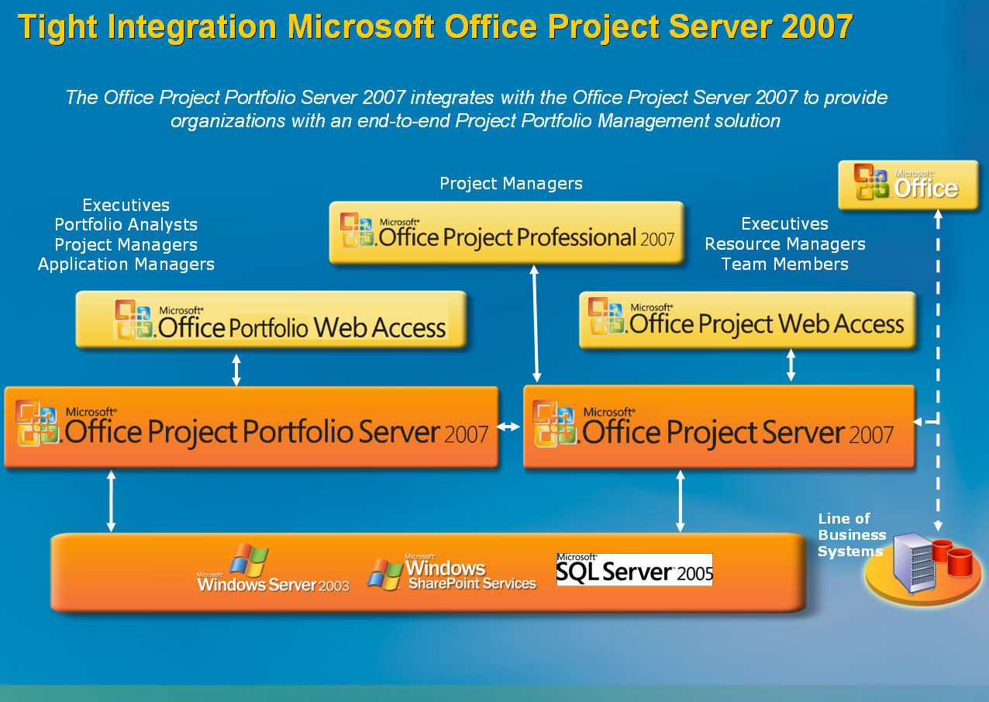
Architecture Overview

Slide 10
Solution Installation Overview
Project Server
Optional
Required
User Workstations
Project Server 2007
Project Professional
Internet Information Services 6.0+
Internet Explorer
Application Server
Excel 2003+
Windows 2003 Server
Project Portfolio Server
Windows XP+
SQL Server 2005 Reporting Services
SharePoint Server
.NET v2.0
Database Server
Windows SharePoint Portal Server
Internet Information Services 6.x
SQL Server 2005 SP1
Windows 2003 Server
Windows 2003 Server
Windows 2003 Server
Project Portfolio Server is an independent server with bi-directional integration to Microsoft Project, Project Server, and SharePoint
Notes:
Session 1
Implementation Workshop
10
This is a Portfolio Server centric view of the server installation.
Note that we use SQL Server Reporting Services for the reports
You have the option to integrate with Project Server and SharePoint
Note that the Portfolio Server tool can be implemented independently of Project Server – or together with it
The gateway provides the link between Project and Reporting Services
This is a typical implementation, for example reporting services can be in the db server if there are different security requirements

Slide 11
Architecture Summary
Application Tier
Project Portfolio Server 2007 Application
Project Portfolio Server Scheduler
Requires .Net Framework 2.0
Compatible with WSS 3.0
Database Tier
PPSAccountIndex
PPSAccountData
Reporting Tier
SQL Reporting Services

Slide 12
6 Deployment Scenarios
Scenario | MOPPS 2007 | SQL Server 2005 | SQL Reporting Services | WSS 3.0 | Project Server 2007
1. Server farm full deployment, incl. MOPS 2007 and WSS 3.0 | Server 1 | Server 2 | Server 3 | Server 4 | Server 4
2. Server farm deployment, incl. WSS 3.0 | Server 1 | Server 2 | Server 3 | Server 4 | -
3. Server farm stand-alone deployment | Server 1 | Server 2 | Server 3 | - | -
4. Single server full deployment, incl. MOPS 2007 and WSS 3.0 | Server 1 | Server 1 | Server 1 | Server 1 | Server 1
5. Single server deployment, incl. WSS 3.0 | Server 1 | Server 1 | Server 1 | Server 1 | -
6. Single server stand-alone deployment | Server 1 | Server 1 | Server 1 | - | -
Notes:
Session 1
Implementation Workshop
12

Slide 13
Scenario 1
Server farm full deployment, including Office Project Server 2007 and Windows SharePoint Services 3.0
Most scalable solution
Supports most concurrent users
Interaction MOPPS 2007 and MOPS 2007.
The deployment consists of
dedicated MOPPS 2007
dedicated SQL Server Reporting Services
dedicated MOPS 2007 and WSS 3.0
shared SQL Server for MOPPS, MOPS, WSS and RS
Notes:
Session 1
Implementation Workshop
13

Slide 14
Scenario 2
Server farm deployment, including Windows SharePoint Services 3.0
No MOPS 2007, can be installed later
The deployment consists of
dedicated MOPPS 2007
dedicated SQL Server Reporting Services
dedicated WSS 3.0
shared SQL Server for MOPPS, WSS and RS
Notes:
Session 1
Implementation Workshop
14

Slide 15
Scenario 3
Server farm stand-alone Office Project Portfolio Server 2007 deployment
No MOPS 2007, can be installed later
No WSS 3.0, can be installed later
The deployment consists of
dedicated MOPPS 2007
dedicated SQL Server Reporting Services
shared SQL Server for MOPPS and WSS
Notes:
Session 1
Implementation Workshop
15

Slide 16
Scenario 4
Single server full deployment, including Office Project Server 2007 and Windows SharePoint Services 3.0
For evaluation MOPPS 2007
Including MOPS 2007 and WSS 3.0
Small number of concurrent users and entities
Note:
WSS 3.0 can not be installed on the same web site as MOPPS 2007.
Notes:
Session 1
Implementation Workshop
16

Slide 17
Scenario 5
Single server deployment, including Windows SharePoint Services 3.0
For evaluation MOPPS 2007
Including WSS 3.0
Small number of concurrent users and entities
Note:
WSS 3.0 can not be installed on the same web site as MOPPS 2007.
Notes:
Session 1
Implementation Workshop
17

Slide 18
Scenario 6
Single server stand-alone Office Project Portfolio Server deployment
For evaluation MOPPS 2007
Small number of concurrent users and entities
Notes:
Session 1
Implementation Workshop
18

Slide 19
Project Portfolio Server 2007
Hardware Sizing: Stress Agents
Application Server
Scheduler Service
Report Generation
Desktop (ActiveX Controls: Optimizer)
Notes:
Session 1
Implementation Workshop
19

Slide 20
Project Portfolio Server 2007
Application Server Minimum Requirements
Hardware
2 x 2.5 GHz Processor class machine
1 GB RAM, 2GB recommended
1 GB disk space for the application
Operating System, Web Server and Utilities
Microsoft Windows 2003 Server (32 bits)
Microsoft Internet Information Services 6.x
Microsoft .NET v2.0
Software
Microsoft Office Project Portfolio Server 2007
Notes:
Session 1
Implementation Workshop
20

Slide 21
Project Portfolio Server 2007
Database Server Minimum Requirements
Hardware
2 x 2.5 GHz Processor class machine
2 GB RAM
Database size typically 200MB-2GB (largest customer = 8GB)
Operating System and Database
Microsoft Windows 2003 Server (64 or 32-bits)
Microsoft SQL Server 2005 Standard/Enterprise Edition SP1
Notes:
Session 1
Implementation Workshop
21

Slide 22
Project Portfolio Server 2007
Report Server Minimum Requirements
Hardware
2 x 2.5 GHz Processor class machine
1 GB RAM, 2GB recommended
Operating System and Database
Microsoft Windows 2003 Server (64 or 32 bits)
Microsoft SQL Server 2005 Reporting Services SP1
Microsoft Project Portfolio Server 2007 (certain subcomponents)
Notes:
Session 1
Implementation Workshop
22

Slide 23
Project Portfolio Server 2007: Real Life Sizing
Portfolio Application Server (500 users)
4 x 3.0 GHz Processor server
4 GB RAM
Portfolio Application Server (1,000 users)
8 x 3.0 GHz Processor server
4 GB RAM
Database Server
2 x 3.0 GHz Processor server
4 GB RAM
Reporting Server (distributed)
2 x 3.0 GHz Processor server
4 GB RAM
Notes:
Session 1
Implementation Workshop
23

Slide 24
Project Portfolio Server 2007
Client Minimum Requirements
Hardware
700MHz, 128MB RAM, 40GB disk space
Operating System
Microsoft Windows XP SP2 or later, Microsoft Windows Vista
Software
Microsoft Internet Explorer 6.0 or higher
For use of the Optimizer and Data Import
Microsoft Excel 2003 or higher
Excel, Trust access to Visual Basic Project should be enabled
Download and install rights of ActiveX components
Notes:
Session 1
Implementation Workshop
24

Slide 25

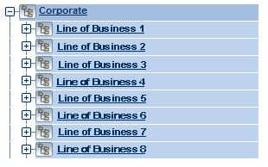
EPM Integration Extensibility
Consolidate and Analyze Projects across Federated Project Servers
Portfolio Management
Data Transfer
Enterprise Project Mgt
Project Portfolio Server
①
②
③
Portfolio Analysts can link multiple Project Servers to Project Portfolio Server to create an enterprise governance repository
Notes:
Session 1
Implementation Workshop
25
An enterprise governance repository is a central place for all appropriate information across the entire enterprise solution.

Slide 26
Getting Started – Quick List
Installation
Performance/sizing requirements (number of users, projects etc.), select appropriate hardware
Start-up requirements, enable all required dependencies (Project Server, SharePoint, etc.)
Configuration
Business processes, define Workflows
Organizational structure, create hierarchies
User roles

Slide 27
User Authentication Scheme
Windows Account
Application Account (.NET)
Choose only one per account

Slide 28
Best Practices
The application server requires the most processing power
Automatic Attribute/Indicator Calculation requires a significant amount of processing time for real time updates (turn off)
Running the Scheduler after hours
Expired attributes recalculation
E-Mail notifications processing and relay
Workflow transitions
Database maintenance

Slide 29
PLEASE READ (hidden slide)
This template is designed for use with Office PowerPoint 2007. The charts and graphics can be edited with PowerPoint 2007, but not with PowerPoint 2003.
This template uses Microsoft’s corporate font, Segoe and Segoe Semibold
Segoe is not a standard font included with Windows, so if you have not already done so, you need to install it on your computer
How to install Segoe: Get the font at: \\Showsrus\images\Corporate_Fonts\PC\Segoe or https://mediabank.partners.extranet.microsoft.com
Copy all the .ttf files into your c:\windows\fonts folder
Questions: email slides@microsoft.com

Slide 30
Notes (hidden)
Some speakers at Microsoft like to use this slide for hidden “notes slides”.
Delete it if you don’t want to use it.
NEXT: <next slide title>

Slide 31
Resources
Deployment Guide: http://www.microsoft.com/downloads/details.aspx?FamilyId=8977C122-A64F-4C4E-A78B-0EA8E150FE3A&displaylang=en
Programmer’s Guide: http://www.microsoft.com/downloads/details.aspx?FamilyId=18848D8B-6784-4E6A-B716-96D571EEB676&displaylang=en
SDK: http://www.microsoft.com/downloads/details.aspx?familyid=2672f6f9-7028-4b30-99a2-18cb1eed1abe&displaylang=en
EPM University: http://www.msepmu.com/courses.htm

Slide 32
Q&A

Slide 33
We need your feedback!
We really value your feedback to help us develop future Microsoft events.
Please fill in your session feedback form now and hand in your completed form before you leave the event. Please remember to note which sessions you have attended.

Slide 34

© 2007 Microsoft Corporation. All rights reserved.
Microsoft, Windows, Windows Vista and other product names are or may be registered trademarks and/or trademarks in the U.S. and/or other countries. The information herein is for informational purposes only and represents the current view of Microsoft Corporation as of the date of this presentation. Because Microsoft must respond to changing market conditions, it should not be interpreted to be a commitment on the part of Microsoft, and Microsoft cannot guarantee the accuracy of any information provided after the date of this presentation.
MICROSOFT MAKES NO WARRANTIES, EXPRESS, IMPLIED OR STATUTORY, AS TO THE INFORMATION IN THIS PRESENTATION.

